Slide 1
Nested Subqueries

Slide 2
Subqueries and Their Uses
A subquery is a query within another query. The outer query is called as main query and inner query is called as subquery Used when a query is based on an unknown value
Must be enclosed in parentheses
Place on right side of comparison operator
Subquery can be placed in a number of SQL clauses: WHERE clause, HAVING clause, FROM clause.
Subqueries can be used with SELECT, UPDATE, INSERT, DELETE statements along with expression operator. It could be equality operator or comparison operator such as =, >, =, <= and Like operator.

Slide 3
The subquery generally executes first, and its output is used to complete the query condition for the main or outer query.
ORDER BY command cannot be used in a Subquery. GROUPBY command can be used to perform same function as ORDER BY command.
Use single-row operators with single row Subqueries. Use multiple-row operators with multiple-row Subqueries.

Slide 4
Subquery
A subquery is a SELECT statement embedded in a clause of another SQL statement.
Main
Query
SELECT . . .
FROM . . .
WHERE . . .
(SELECT . . .
FROM . . .
WHERE . . .)
Subquery
Notes:
What Is a Subquery?
A subquery is a SELECT statement that is embedded in the clause of another SQL statement.
The subquery (inner query) returns a value that is used by the main query (outer query). Using a subquery is equivalent to performing two sequential queries, and using the result of the first query as the search value in the second query.
Subqueries can be used for the following purposes:
To provide values for conditions in WHERE, HAVING, and START WITH clauses of SELECT, UPDATE, and DELETE statements
To define the set of rows to be inserted into the target table of an INSERT or CREATE TABLE statement
To define the set of rows to be included in a view or snapshot in a CREATE VIEW or CREATE SNAPSHOT statement
To define one or more values to be assigned to existing rows in an UPDATE statement
To define a table to be operated on by a containing query. You do this by placing the subquery in the FROM clause. This can be done in INSERT, UPDATE, and DELETE statements as well.
Note: A subquery is evaluated once for the entire parent statement.

Slide 5
Subqueries
The subquery (inner query) executes once before the main query.
The result of the subquery is used by the main query (outer query).
SELECT select_list
FROM table
WHERE expr operator (SELECT select_list
FROM table);
Notes:
Subqueries
You can build powerful statements out of simple ones by using subqueries. They can be very useful when you need to select rows from a table with a condition that depends on the data in the table itself.
In the syntax:
operator includes a comparison operator such as >, =, or IN.
Note: Comparison operators fall into two classes: single-row operators (>, =, >=, <, <>, <=) and multiple-row operators (IN, ANY, ALL).
The subquery is often referred to as a nested SELECT, sub-SELECT, or inner SELECT statement.

Slide 6
Using a Subquery
SQL> SELECT ename
2 FROM emp
3 WHERE sal >
4 (SELECT sal
5 FROM emp
6 WHERE empno = 7566);
2975
ENAME
----------
KING
FORD
SCOTT
Notes:
Using a Subquery
In the slide, the inner query returns the salary of employee 7566. The outer query takes the result of the inner query and uses this result to display the names of all the employees who earn more than this amount.
Subqueries are very useful for writing SQL statements that need values based on an unknown conditional value.
Examples
Create a duplicate of the DEPT table.
Display all employees who make less than the average salary in the company.
Class Management Note
Execute the subquery (inner query) on its own first to show the value that the subquery returns. Then execute the outer query using the result returned by the inner query. Finally, execute the entire query (containing the subquery) and show that the result is the same.
SQL> CREATE TABLE dept_copy(deptno, dname, loc)
2 AS SELECT deptno, dname, loc
3 FROM dept;
SQL> SELECT ename, job, sal
2 FROM emp
3 WHERE sal < (SELECT AVG(sal)
4 FROM emp);

Slide 7
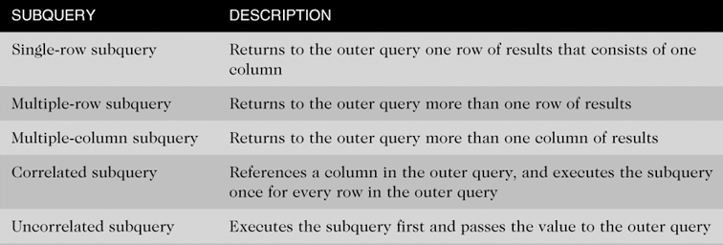
Types of Subqueries

Slide 8
Single-Row Subqueries
Can only return one result to the outer query
Operators include =, >, <, >=, <=, < >

Slide 9
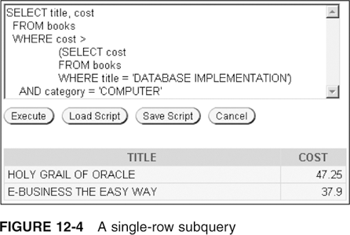
Single-Row Subquery in a WHERE Clause
Used for comparison against individual data

Slide 10
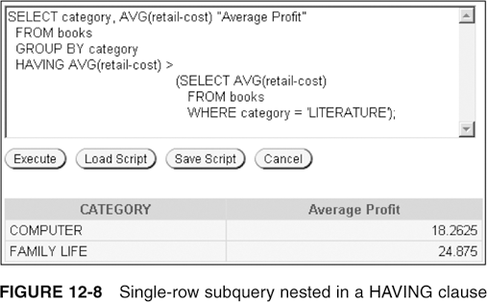
Single-Row Subquery in a HAVING Clause
Required when returned value is compared to grouped data

Slide 11
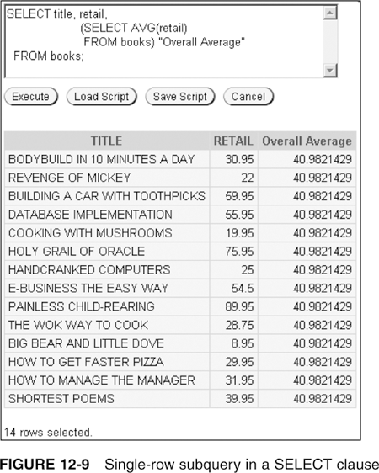
Single-Row Subquery in a SELECT Clause
Replicates subquery value for each row displayed

Slide 12
Multiple-Row Subqueries
Return more than one row of results
Require use of IN, ANY, ALL, or EXISTS operators

Slide 13
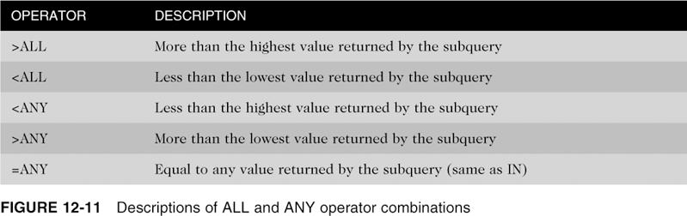
ANY and ALL Operators
Combine with arithmetic operators

Slide 14
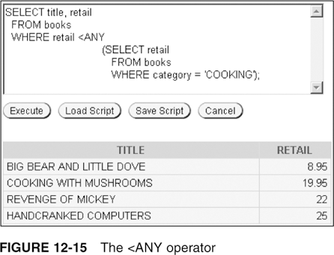
Multiple-Row Subquery in a WHERE Clause (continued)

Slide 15
Multiple-Column Subqueries
Return more than one column in results
Can return more than one row
Column list on the left side of operator must be in parentheses
Use the IN operator for WHERE and HAVING clauses

Slide 16
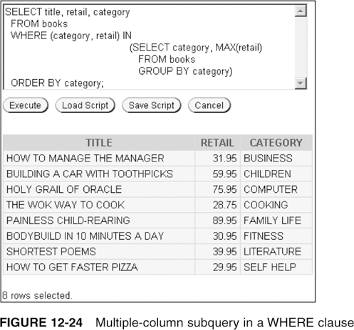
Multiple-Column Subquery in a WHERE Clause
Returns multiple columns for evaluation

Slide 17
Uncorrelated Subqueries
Processing sequence:
Inner query is executed first
Result is passed to outer query
Outer query is executed

Slide 18
Correlated Subqueries
Used to affect row-by-row processing, each subquery is executed once for every row of the outer query.
GET
candidate row
EXECUTE
inner query using candidate row value
USE
value(s) from inner query to qualify candidate row
Notes:
Correlated Subqueries
A correlated subquery is a nested subquery that is evaluated once for each row processed by the main query, and that on execution uses a value from a column in the outer query.
Nested Subqueries Versus Correlated Subqueries
With a normal nested subquery, the inner SELECT runs first and executes once, returning values to be used by the main query. A correlated subquery, on the other hand, executes once for each candidate row considered by the outer query. In other words, the inner query is driven by the outer query.
Correlated Subquery Execution
1. Get a candidate row (fetched by the outer query).
2. Execute the inner query using the value of the candidate row.
3. Use the value(s) resulting from the inner query to qualify or disqualify the candidate.
4. Repeat until no candidate row remains.
Although this discussion focuses on correlated subqueries in SELECT statements, it also applies to correlated UPDATE and DELETE statements.

Slide 19
Using Correlated Subqueries
Find all employees who make more than the average salary in their department.
SQL> SELECT empno, sal, deptno
2 FROM emp outer
3 WHERE sal > (SELECT AVG(sal)
4 FROM emp inner
5 WHERE outer.deptno = inner.deptno);
Each time the outer query
is processed the
inner query is
evaluated.
EMPNO SAL DEPTNO
-------- --------- ---------
7839 5000 10
7698 2850 30
7566 2975 20
...
6 rows selected.
Notes:
Using Correlated Subqueries
In the example, we determine which employees earn more than the average salaries for their departments. In this case, the correlated subquery specifically computes the average salary for each department.
Because the outer query and inner query both use the EMP table in the FROM clause, an alias is given to EMP in each separate SELECT statement for clarity. Not only does the alias make the entire SELECT statement more readable, without the alias the query would not work properly because the inner statement would not be able to distinguish the inner table column from the outer table column.

Slide 20
Using the EXISTS Operator
If a subquery row value is found:
The search does not continue in the inner query.
The condition is flagged TRUE.
If a subquery row value is not found:
The condition is flagged FALSE.
The search continues in the inner query.
Notes:
EXISTS Operator
With nesting SELECT statements, all logical operators are valid. In addition, you can use the EXISTS operator. This operator is frequently used with correlated subqueries. It tests whether a value is there. If the value exists, it returns TRUE; if the value does not exist, it returns FALSE. Similarly, NOT EXISTS ensures that a value is not there.

Slide 21
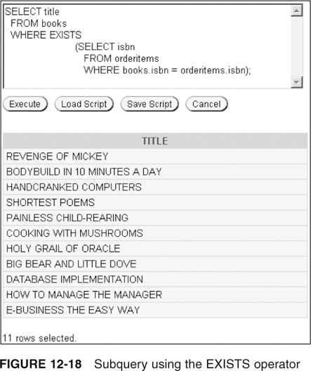
EXISTS Operator
Determines whether condition exists in subquery

Slide 22
Using the EXISTS Operator
Find employees who have at least one person reporting to them.
SQL> SELECT empno, ename, job, deptno
2 FROM emp outer
3 WHERE EXISTS (SELECT empno
4 FROM emp inner
5 WHERE inner.mgr = outer.empno);
EMPNO ENAME JOB DEPTNO
--------- ---------- --------- ---------
7839 KING PRESIDENT 10
7698 BLAKE MANAGER 30
7782 CLARK MANAGER 10
7566 JONES MANAGER 20
...
6 rows selected.
Notes:
Using the EXISTS Operator
The EXISTS operator ensures that the search in the inner query will not continue when at least one match is found for the manager and employee numbers.

Slide 23
Using the NOT EXISTS Operator
Find all departments that do not have any employees.
SQL> SELECT deptno, dname
2 FROM dept d
3 WHERE NOT EXISTS (SELECT '1'
4 FROM emp e
5 WHERE d.deptno = e.deptno);
DEPTNO DNAME
--------- ----------
40 OPERATIONS
Notes:
Using the EXISTS Operator (continued)
Note that the inner SELECT does not need to return a specific value, so a literal can be selected. From a performance standpoint, it is faster to select a constant than a column.
Alternative Solution
As shown in the previous example, a NOT IN construct can be used as an alternative for a NOT EXISTS. However, caution should be used. NOT IN evaluates to FALSE if any member of the set is NULL. In that case your query will not return any rows.
SQL> SELECT deptno, dname
2 FROM dept
3 WHERE deptno NOT IN (SELECT deptno
4 FROM emp);

Slide 24
Correlated UPDATE
Use a correlated subquery to update rows in one table based on rows from another table.
UPDATE table1 alias1
SET column = (SELECT expression
FROM table2 alias2
WHERE alias1.column = alias2.column);
Notes:
Using Correlated Subqueries
In the case of the UPDATE statement, you can use a correlated subquery to update rows in one table based on rows from another table.
Example
Denormalize the EMP table by adding a column to store the department name. Then populate the table using a correlated update.

Slide 25
Correlated DELETE
Use a correlated subquery to delete only those rows that also exist in another table.
DELETE FROM table1 alias1
WHERE column operator
(SELECT expression
FROM table2 alias2
WHERE alias1.column = alias2.column);
Notes:
Using Correlated Subqueries (continued)
In the case of a DELETE statement, you can use a correlated subquery to delete only those rows that also exist in another table.
Example
Write a query to find all records with duplicate employee numbers and delete the duplicate rows from the EMP table.
Note: The FOR UPDATE clause locks the rows selected by the query. Other users cannot lock or update the selected rows until you end your transaction.
SQL> SELECT ename
2 FROM emp outer
3 WHERE ROWID > (SELECT MIN(ROWID)
4 FROM emp inner
5 WHERE outer.empno = inner.empno)
6 FOR UPDATE;
SQL> DELETE FROM emp outer
2 WHERE ROWID > (SELECT MIN(ROWID)
3 FROM emp inner
4 WHERE outer.empno = inner.empno);

Slide 26
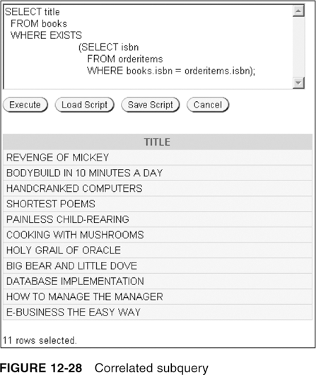
Correlated Subqueries

Slide 27
Nested Subqueries
Maximum of 255 subqueries if nested in the WHERE clause
No limit if nested in the FROM clause
Innermost subquery is resolved first, then the next level, etc.

Slide 28
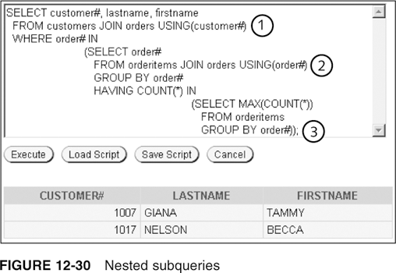
Nested Subqueries
Innermost is resolved first (3), then the second level (2), then the outer query (1)

